Slide 1
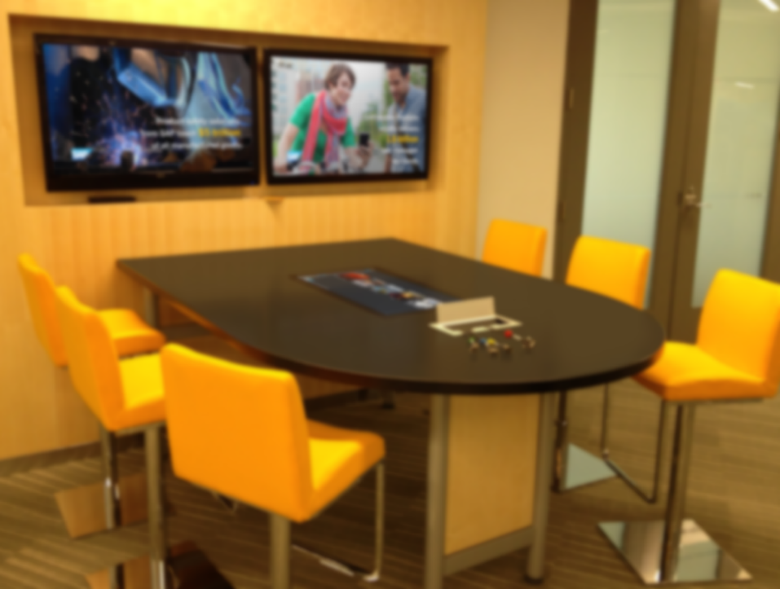
4K Multiviewer 1T-MV-8474
1T-MV-8474 - 4K Multiviewer
Seven video inputs
4 x HDMI to UHD 4k/30
2 x DisplayPort to UHD 4K/60
1 x VGA/YPbPr
Single HDMI Output
Up to UHD 4K/30
Display four windows
Choose from 16 layouts
Audio Control
Input: 7 x Analogue Audio
Output: HDMI embedded, 4 x Analogue & 1 x Digital Toslink
Audio embedding
Audio Delay
Control
RS-232, Ethernet or remote control
Name
Role

Slide 2

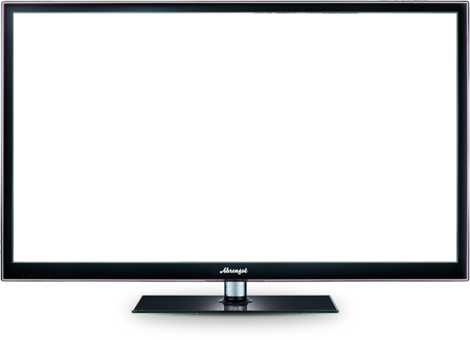





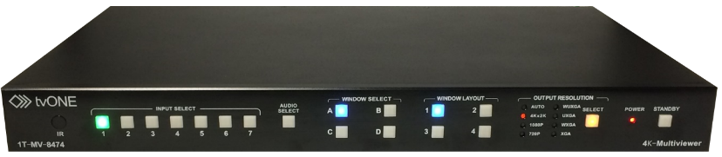
1T-MV-8474 4K Multiviewer
1T-MV-8474
Collaborate
Combine
Simplicity

Slide 3
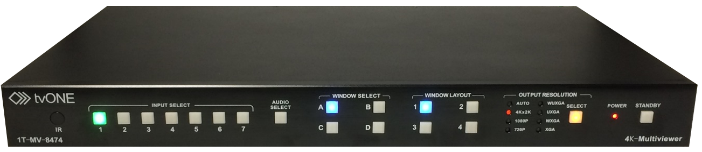
1T-MV-8474 - 4K Multiviewer
1T-MV-8474 - 4K Multiviewer
Seven video inputs
4 x HDMI to UHD 4k/30
2 x DisplayPort to UHD 4K/60
1 x VGA/YPbPr
Single HDMI Output
Up to UHD 4K/30
Display four windows
Choose from 16 layouts
Audio Control
Input: 7 x Analogue Audio
Output: HDMI embedded, 4 x Analogue & 1 x Digital Toslink
Audio embedding
Audio Delay
Control
RS-232, Ethernet or remote control
Collaborate - Perfect solution for all collaborative applications including huddle rooms, education, medical & control rooms.
Combine - UHD 4K/60, UHD/4K, 1080p and other resolutions for maximum flexibility.
Simplicity - Easy to use button control or remote control

Slide 4




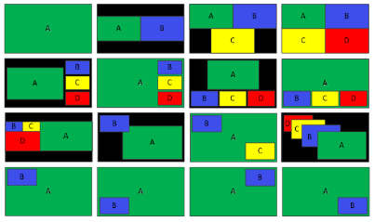
1T-MV-8474 - 4K Multiviewer
1T-MV-8474 - 4K Multiviewer
Seven video inputs
4 x HDMI to UHD 4k/30
2 x DisplayPort to UHD 4K/60
1 x VGA/YPbPr
Single HDMI Output
Up to UHD 4K/30
Display four windows
Choose from 16 layouts
Audio Control
Input: 7 x Analogue Audio
Output: HDMI embedded, 4 x Analogue & 1 x Digital Toslink
Audio embedding
Audio Delay
Control
RS-232, Ethernet or remote control
Input 1
Window B
Input 2
Window A
Window C
Input 3
Input 4
Window D
Input
Audio
Window
Layout
Resolution
Notes:
Simplicity – 4K multiviewer & capable presentation switcher
Designed for quick and easy collaboration for meeting rooms & huddle rooms together with more traditional applications such as monitoring and control rooms.
Seven Inputs
4 x HDMI (up to UHD 4K/30)
2 x DisplayPort (up to UHD 4K/60)
1 x HD15 (VGA/YPbPr)
7 x Analogue Stereo Audio
Format Compliance HDMI v1.4, DVI v1.0, DisplayPort v1.2, HDCP v1.4
Audio de-embedding & re-embedding
Audio delay up 400 m/s in 40 m/s steps
One Output - HDMI (up to UHD 4K/30)
Cascade able
Sixteen fixed layouts:
Quad split
Picture in Picture
Triple
Side by Side
Full Screen

Slide 5
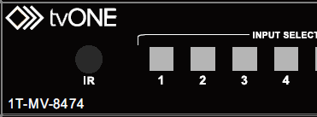
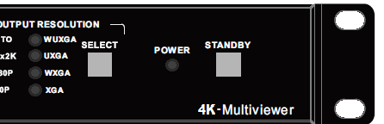
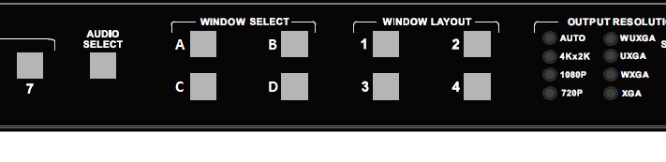

1T-MV-8474 - 4K Multiviewer
1T-MV-8474 - 4K Multiviewer
Seven video inputs
4 x HDMI to UHD 4k/30
2 x DisplayPort to UHD 4K/60
1 x VGA/YPbPr
Single HDMI Output
Up to UHD 4K/30
Display four windows
Choose from 16 layouts
Audio Control
Input: 7 x Analogue Audio
Output: HDMI embedded, 4 x Analogue & 1 x Digital Toslink
Audio embedding
Audio Delay
Control
RS-232, Ethernet or remote control
Flexible multiviewer & capable presentation switcher
Seven Inputs
4 x HDMI (up to UHD 4K/30)
2 x DisplayPort (up to UHD 4K/60)
1 x HD15 (VGA/YPbPr)
7 x Analogue Stereo Audio
Audio de-embedding & re-embedding
Single HDMI Output (up to UHD 4K/30)
Sixteen fixed layouts:
Quad split
Picture in Picture
Triple
Side by Side
Full Screen

Slide 6
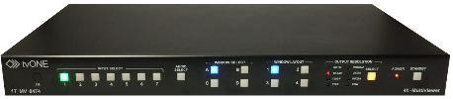
1T-MV-8474 - 4K Multiviewer
1T-MV-8474 - 4K Multiviewer
Seven video inputs
4 x HDMI to UHD 4k/30
2 x DisplayPort to UHD 4K/60
1 x VGA/YPbPr
Single HDMI Output
Up to UHD 4K/30
Display four windows
Choose from 16 layouts
Audio Control
Input: 7 x Analogue Audio
Output: HDMI embedded, 4 x Analogue & 1 x Digital Toslink
Audio embedding
Audio Delay
Control
RS-232, Ethernet or remote control
Perfect solution for all collaborative applications including huddle rooms, education, medical & control rooms.
Combine UHD 4K/60, UHD/4K, 1080p and other resolutions for maximum flexibility.
Easy to use button control or remote control

Slide 7
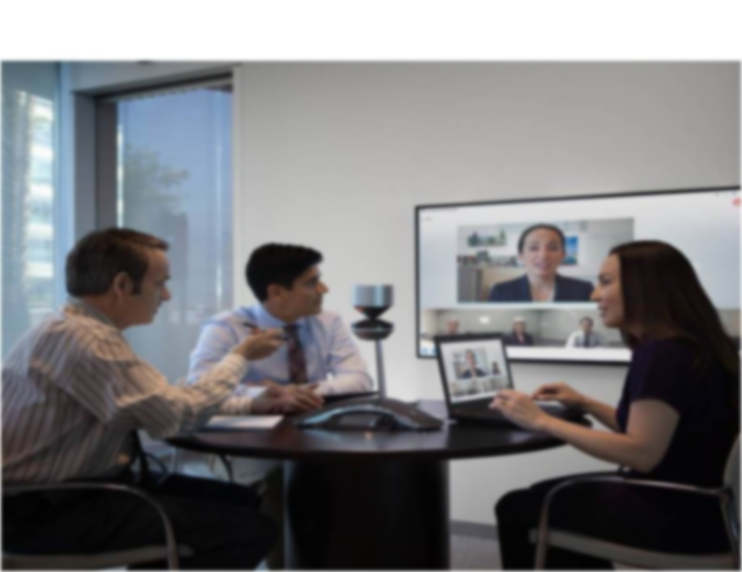
Any Questions?
1T-MV-8474 - 4K Multiviewer
Seven video inputs
4 x HDMI to UHD 4k/30
2 x DisplayPort to UHD 4K/60
1 x VGA/YPbPr
Single HDMI Output
Up to UHD 4K/30
Display four windows
Choose from 16 layouts
Audio Control
Input: 7 x Analogue Audio
Output: HDMI embedded, 4 x Analogue & 1 x Digital Toslink
Audio embedding
Audio Delay
Control
RS-232, Ethernet or remote control

