Slide 1
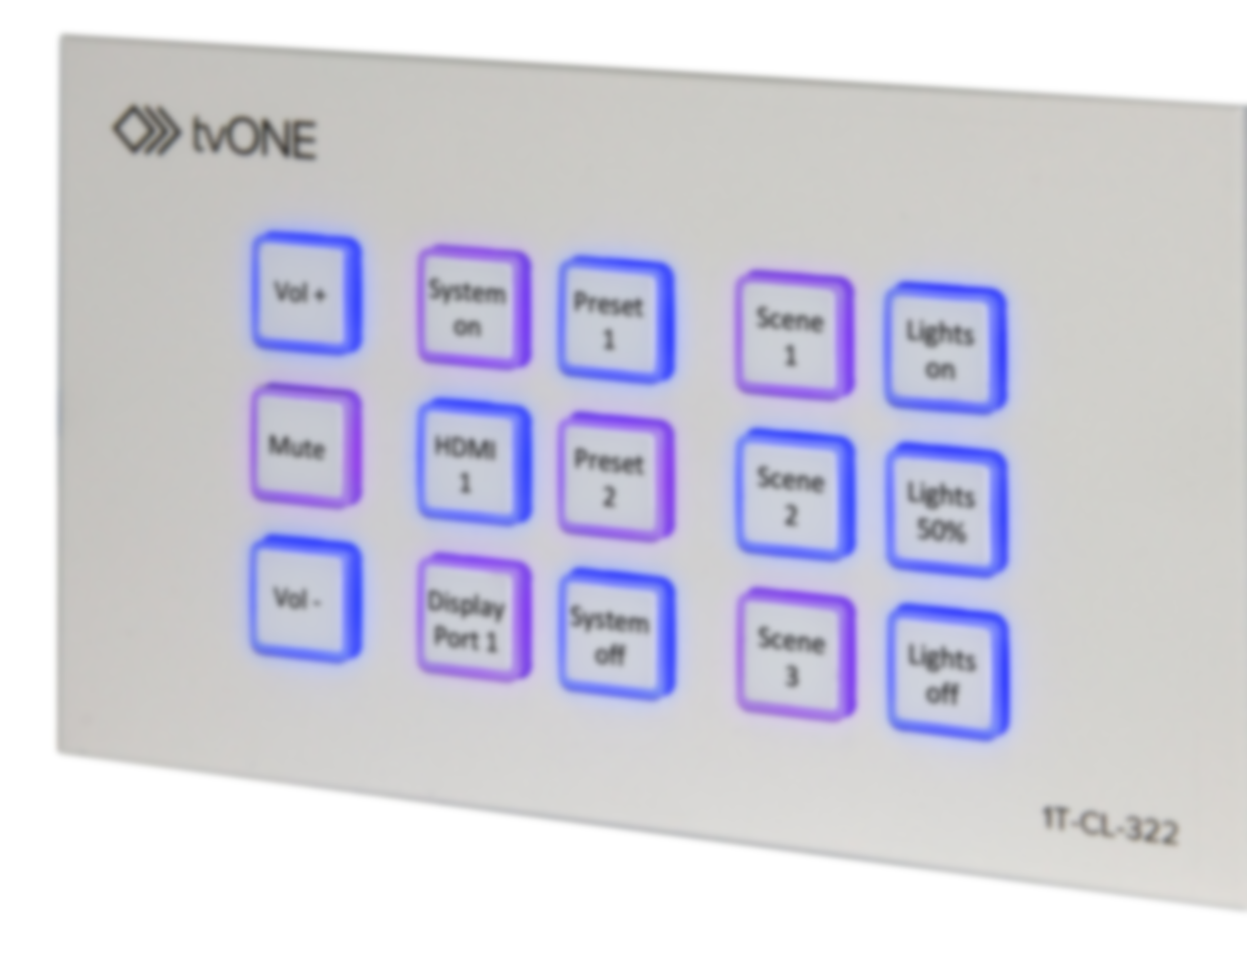
Control Panel 1T-MV-8474
Name
Role

Slide 2
1T-CL-322-EU Control Panel
1T-CL-322-EU Control Panel
Easy to use
Highly Flexible
Cost Effective

Slide 3
1T-CL-322-EU Overview
1T-CL-322-EU Control Panel
Panel
15 Programmable Buttons
Control devices by Ethernet or relays for contact closure
Recall 16 commands from single button push
Other Features
Seven day scheduling
Static or DHCP Ethernet
PoE support
Web Interface
Set up, control & manage multiple 1T-322-EU panels
Panel Emulation mode
Discovery application
15 Button Universal Control Panel:
Buttons
15 programmable, backlit buttons for single function or macro
Allows complex Presets by utilising 16 from 128 stored commands in a single button push
Connections
Ethernet port with Static or DHCP options & POE support
2 Relay Outputs to trigger mechanical devices
Scheduling
Seven day scheduling including Power On/Off or scene changing
LED Button Logic can be configured for user feedback

Slide 4
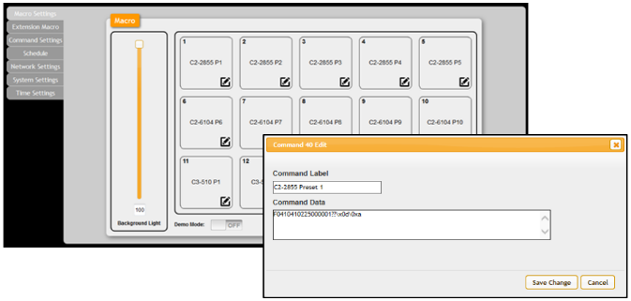
1T-CL-322-EU Programming
1T-CL-322-EU Control Panel
Panel
15 Programmable Buttons
Control devices by Ethernet or relays for contact closure
Recall 16 commands from single button push
Other Features
Seven day scheduling
Static or DHCP Ethernet
PoE support
Web Interface
Set up, control & manage multiple 1T-322-EU panels
Panel Emulation mode
Discovery application
Programming
Simple, flexible Web GUI to manage multiple panels across a network
Web GUI includes Panel Emulator
Includes Discovery application for PC search for panels

Slide 5
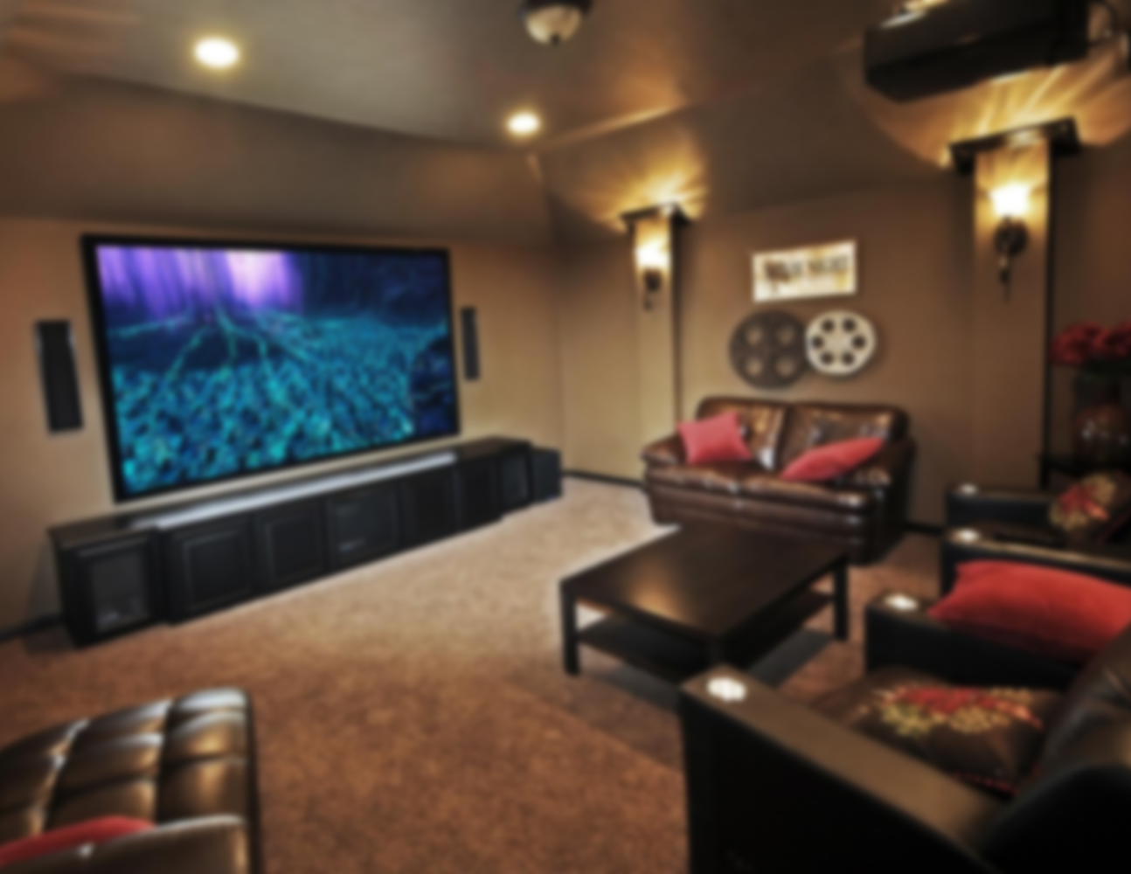
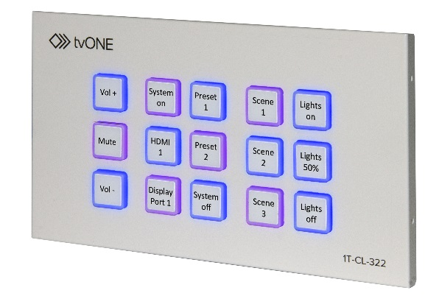
1T-CL-322-EU Application
1T-CL-322-EU Control Panel
Panel
15 Programmable Buttons
Control devices by Ethernet or relays for contact closure
Recall 16 commands from single button push
Other Features
Seven day scheduling
Static or DHCP Ethernet
PoE support
Web Interface
Set up, control & manage multiple 1T-322-EU panels
Panel Emulation mode
Discovery application

Slide 6
1T-CL-322-EU
1T-CL-322-EU Control Panel
Panel
15 Programmable Buttons
Control devices by Ethernet or relays for contact closure
Recall 16 commands from single button push
Other Features
Seven day scheduling
Static or DHCP Ethernet
PoE support
Web Interface
Set up, control & manage multiple 1T-322-EU panels
Panel Emulation mode
Discovery application
Easy to Use
Simple to programme & highly flexible in use
Highly Flexible
Control multiple devices over Ethernet and with contact closure relays
Cost Effective
No need to pay for expensive control system programmers or dedicated control PC’s

Slide 7
Any Questions?
1T-CL-322-EU Control Panel
Easy to use
Highly Flexible
Cost Effective

